Slide 1
MICHAEL GOSPEL PROJECT PRESENTATION

Slide 2
TABLE OF CONTENTS
Introduction / Objective
Dashboard Overview
Key Metrics Summary
Sales Performance by Market
Sales by Category
Regional Performance (Quantity Sold)
Customer Segment Analysis (Discount Impact)
Shipping Mode Analysis
Monthly Profit Trend
Key Insights
Recommendations
Conclusion

Slide 3
Introduction
This presentation analyzes sales, profit, and customer trends.
The goal is to identify:
High-performing regions
Profitable categories
Customer behavior patterns
Insights will support better business decisions.

Slide 4
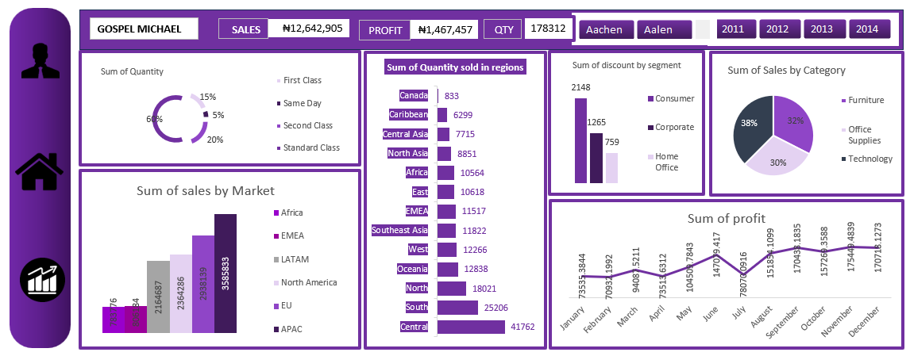
DASHBOARD OVERVIEW

Slide 5
Key Metrics Summary
Total Sales: ₦12,642,905
Total Profit: ₦1,467,457
Total Quantity Sold: 178,312
Insight
Shows overall business performance
Indicates strong revenue with moderate profit margin

Slide 6
Sales Performance by Market
APAC has the highest sales (~3.58M)
EU and North America follow closely
Africa and EMEA have lower contributions
Insight:
Business is strongest in international markets

Slide 7
Sales by Category
Technology: 38% (highest)
Furniture: 32%
Office Supplies: 30%
Insight:
Technology drives the most revenue

Slide 8
Regional Performance (Quantity Sold)
Central region has the highest quantity (41,762)
South and North also perform well
Canada and Caribbean are lowest
Insight:
Demand is concentrated in central regions

Slide 9
Customer Segment Analysis (Discount)
Consumer segment receives highest discount (2148)
Corporate follows (1265)
Home Office lowest (759)
Insight:
Discounts are heavily targeted at consumers
Could be affecting profit margins

Slide 10
Shipping Mode Analysis
Standard Class: 60% (most used)
Second Class: 20%
First Class: 15%
Same Day: 5%
Insight:
Customers prefer cheaper shipping options

Slide 11
Monthly Profit Trend
Profit fluctuates across months
Peaks around:
September
November
Lower performance in early months
Insight:
Sales/profit are seasonal

Slide 12
Key Insights
Technology is the most profitable category
Central region drives the highest demand
Consumer segment gets the most discounts
Standard shipping dominates usage
Profit shows seasonal trends

Slide 13
Recommendations
The Business should:
Focus more on Technology products
Reduce excessive discounts to improve profit
Expand operations in high-performing regions
Introduce incentives for faster shipping options
Plan promotions around high-profit months

Slide 14
Conclusion
The business is performing well in sales
Profit can be improved with better strategies
Data-driven decisions will enhance growth

Slide 15
THANK YOU

